Slide 1
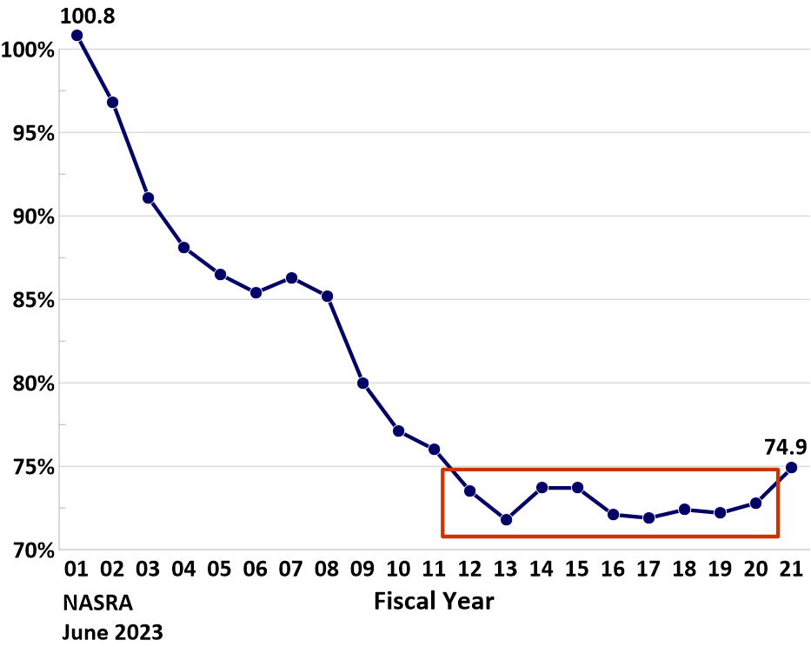
Aggregate public pension funding level,
FY 01 to FY 21

Slide 2
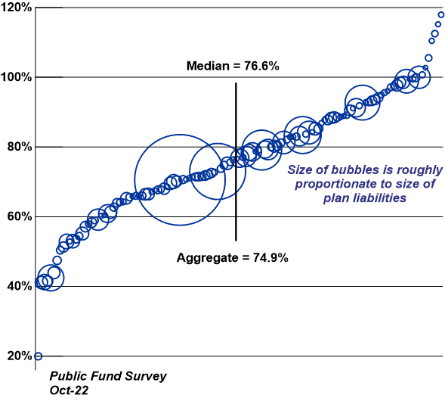
Distribution of public pension funding levels, FY 21

Slide 3
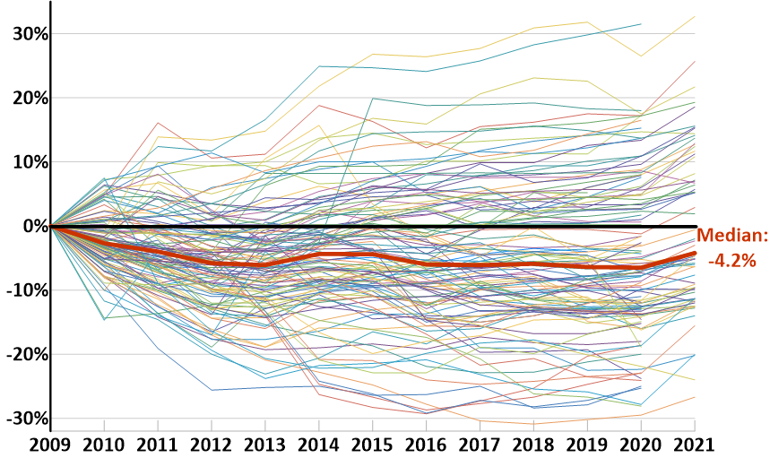
Distribution of changes in funding levels,
FY 09 to FY 21

Slide 4
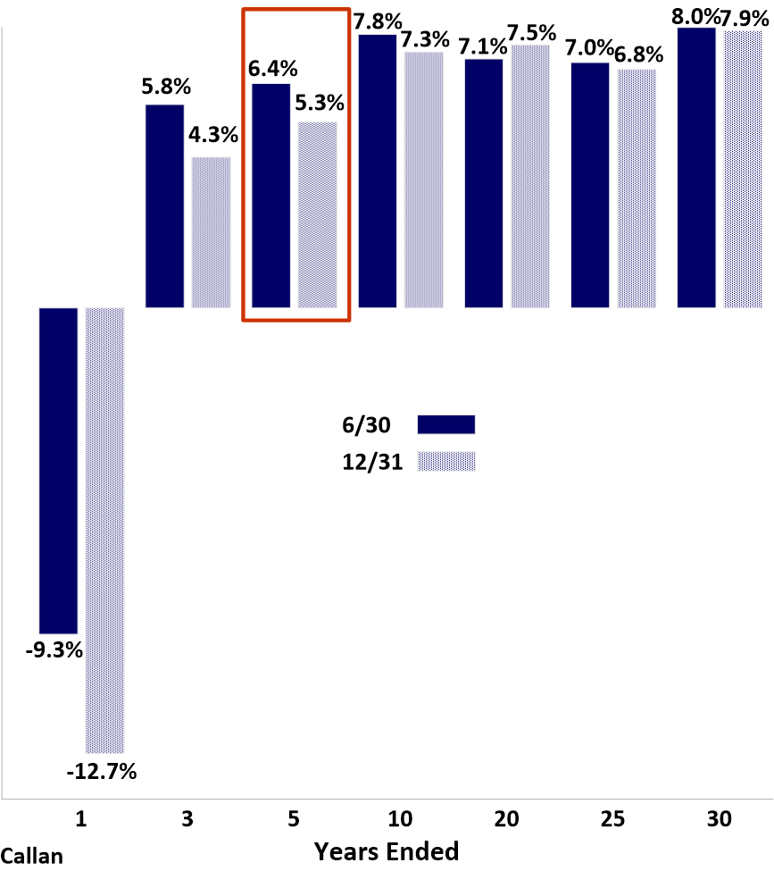
Median annualized public pension fund investment returns for periods ended 6/30/22 and 12/31/22

