Slide 1



Defining the Fiduciary Role of the Trustee
Don Trone, BCF
CEO
don.trone@c-bcf.com

Slide 2
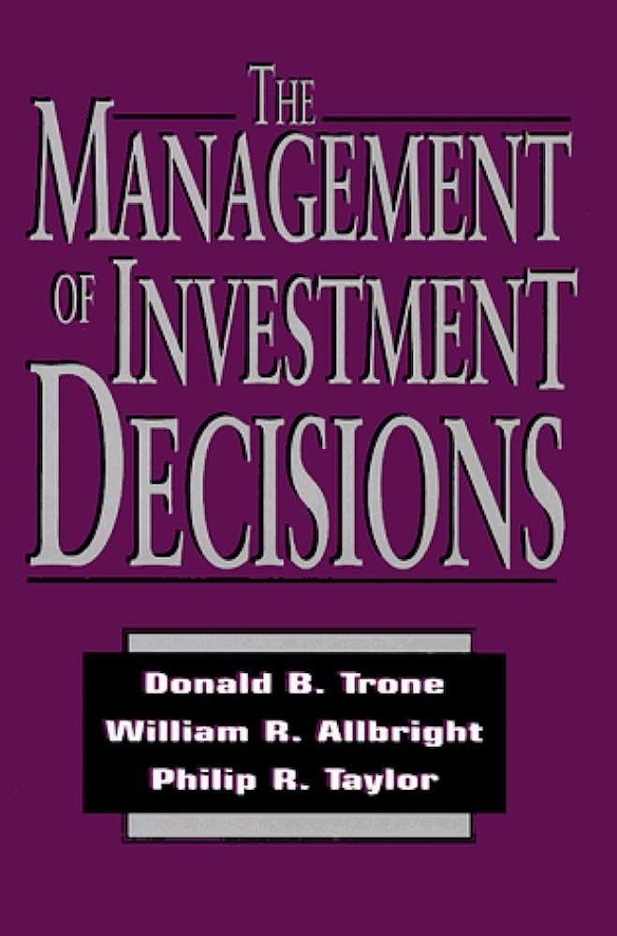

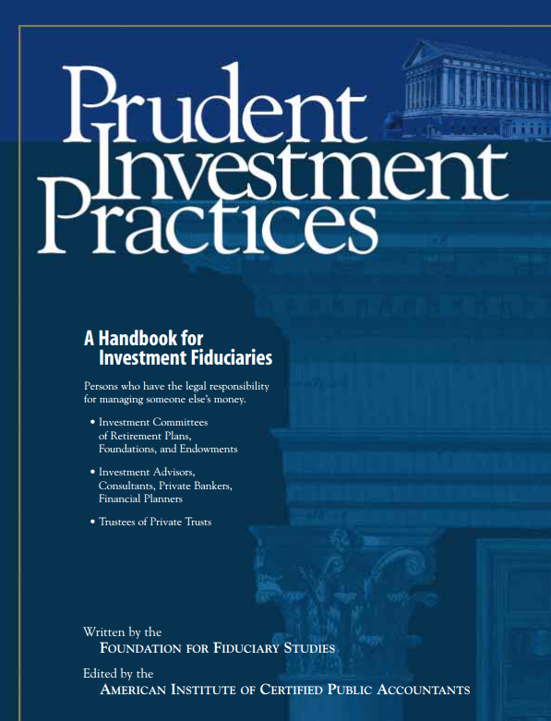
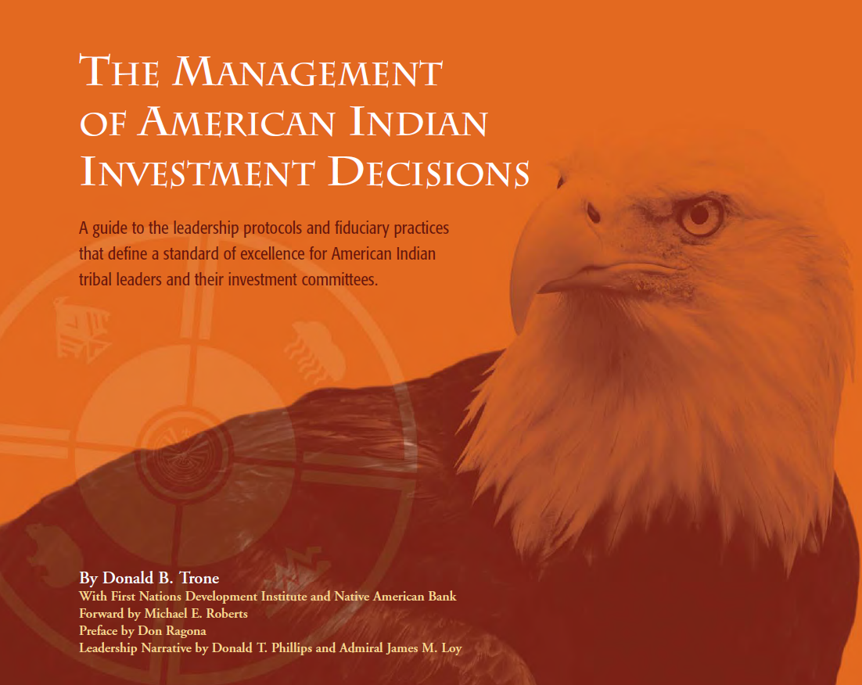
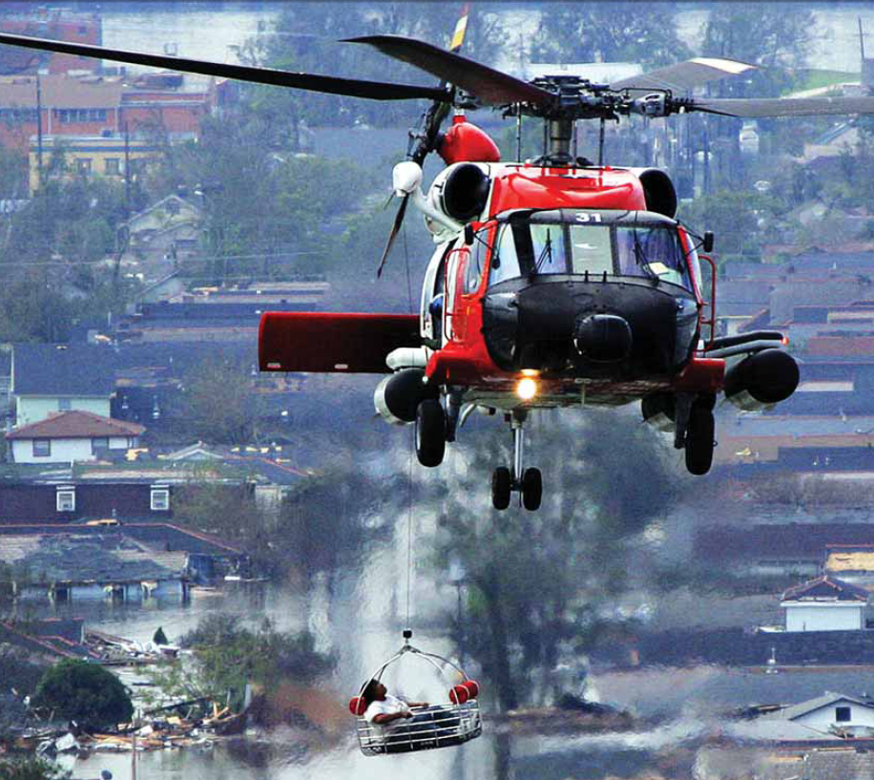

Slide 3

When the roles of regulators and politicians become indistinguishable, often the result are complex rules and regulations that do more harm than good.
Don Trone

Slide 4
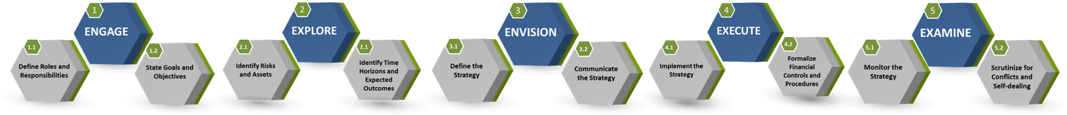
UNIVERSAL GUIDING PRINCIPLES FOR FPPTA PENSION BOARDS
Determine key decision-makers; identify who’s going to lead
Determine sources and levels of risks that may prevent goal attainment
Develop a strategy considering RATE - Risks, Assets, Time Horizon, and Expected Outcomes
Determine whether the right resources, people, and technology are in place
Monitor the strategy to periodically determine whether goals and objectives can be met
Collaboratively develop goals
and objectives with key
decision-makers
Determine sources and levels of assets available for goal attainment
Verify the strategy is inclusive of generally accepted best practices
Employ a consistent due diligence process when selecting prudent experts
Reallocate resources, when necessary, in order to meet goals and objectives
Align goals and objectives with organization's mission and ethics
Determine each goal's time horizon
Verify key decision-makers have the time, talent, technology, and temperament to implement the strategy
Control and account for costs, fees, and expenses
Ensure same due diligence process that was used to select prudent experts is also used to monitor the experts
Align goal and objectives with regulations, policies, and procedures
Determine each goal’s short-term objectives
Confirm reasonableness and appropriateness of costs, fees, and expenses
Formalize process to monitor for self-dealing and conflicts of interest
Brief all key decision-makers on the strategy
Copyright © 2020-2022. Center for Board Certified Fiduciaries, subject to additional licensing agreements with 3ethos and Hannah Leader Development Associates

Slide 5
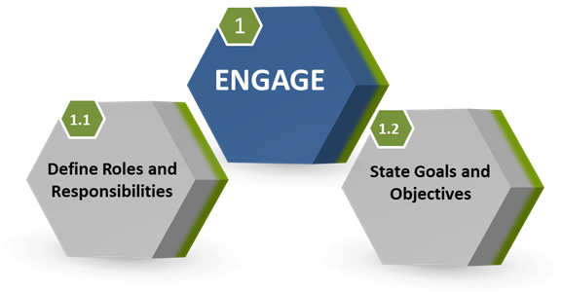
Copyright © 2020-2022. Center for Board Certified Fiduciaries, subject to additional licensing agreements with 3ethos and Hannah Leader Development Associates

Slide 6
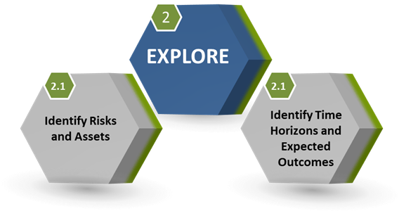
Copyright © 2020-2022. Center for Board Certified Fiduciaries, subject to additional licensing agreements with 3ethos and Hannah Leader Development Associates

Slide 7
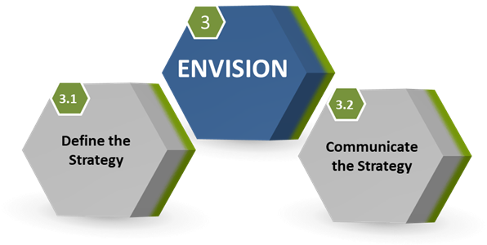

Copyright © 2020-2022. Center for Board Certified Fiduciaries, subject to additional licensing agreements with 3ethos and Hannah Leader Development Associates

Slide 8
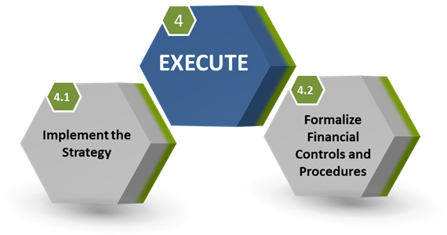
Copyright © 2020-2022. Center for Board Certified Fiduciaries, subject to additional licensing agreements with 3ethos and Hannah Leader Development Associates

Slide 9
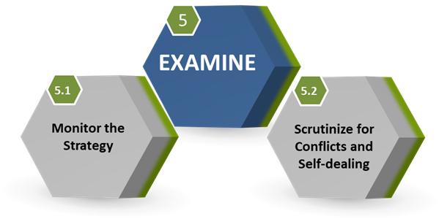
Copyright © 2020-2022. Center for Board Certified Fiduciaries, subject to additional licensing agreements with 3ethos and Hannah Leader Development Associates

Slide 10



