Slide 1
S&P 500® Index Market Capitalization Deciles
2023 YTD Through May
The largest 50 stocks significantly beat the S&P 500® during the first five months of the year while the other 450 stocks have underperformed.

Slide 2
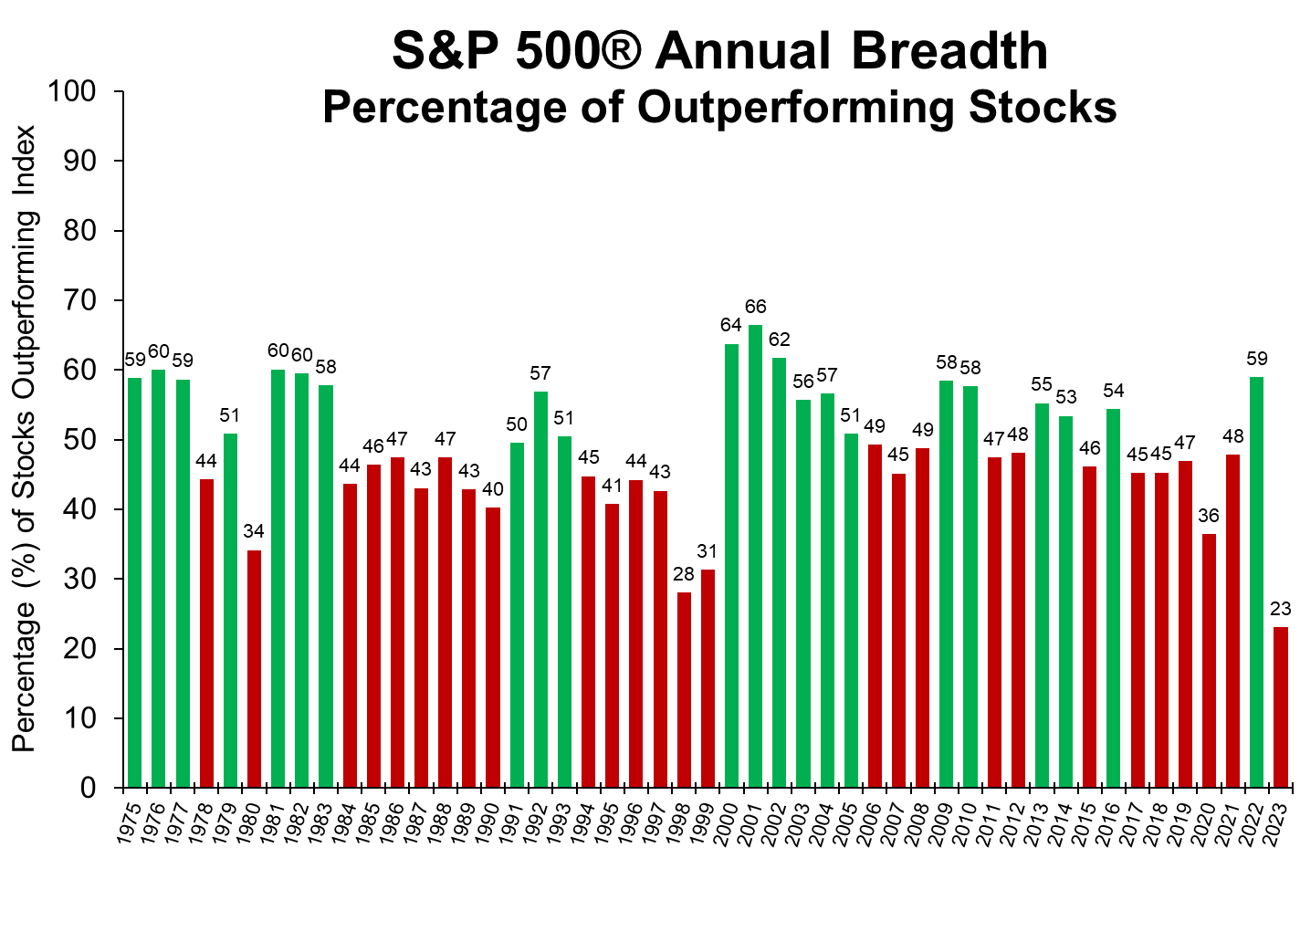
2023 Annual Breadth Lowest Ever
There are less stocks (only 23%) outperforming the market YTD through May than any other calendar year

Slide 3
Daily 1%+ Up/Down S&P 500® Moves – Monthly Counts
January 1957 – May 31 2023
In 2022, 48.6% of days have had 1% moves.
Only two other years (2002 and 2008) had more 1% moves.
In 2023, 35.9% of days have had 1% moves.
Annual average is 53 days (21%) where S&P 500 ® moves by more than +/-1% Up/Down

Slide 4
Relationship between Equity Earnings Yield, 10-year Treasury Bond Yield, and Inflation
Earnings yield on stocks and coupon yield on Bonds typically move in similar way. Correlation of monthly values is 0.65, highly significant.

Slide 5
Unemployment Usually Increases Prior to Recessions
The unemployment rate recently hit a 50-year low and typically begins rising prior to a recession.

Slide 6
Important Disclosures
PAST PERFORMANCE IS NOT NECESSARILY INDICATIVE OF FUTURE RESULTS. INVESTMENTS ARE NOT GUARANTEED AND MAY LOSE VALUE.
TWIN Capital Management, Inc. (“TCM”) is a registered investment advisor founded in April 1990 and headquartered in McMurray, Pennsylvania.
This material in intended as an aid in the education of investors about various investment topics. It is not to be considered an advertisement for any services or specific investment product offered by TWIN. The opinions expressed are those of the presenter.
DEFINITIONS & CALCULATIONS
Annualized Returns are calculated as the compound geometric average monthly returns. The geometric average is the monthly average return that assumes the same rate of return every period to arrive at the equivalent compound growth rate reflected in the actual return data. The results are annualized by raising the sum of one plus the compound geometric average monthly return to the twelfth power and then subtracting one. Standard Deviation measures the dispersion of uncertainty in a random variable (in this case, investment returns). The higher the volatility of investment returns, the higher the standard deviation will be in any given case. For this reason, standard deviation is often used as a measure of investment risk. Values are calculated by applying the traditional sample deviation formula to monthly return data, and then annualized by multiplying the result by the square root of twelve.
INDEX INFORMATION
The S&P 500 Index is a representative measure of 500 leading companies from leading industries; the index is a benchmark for the large-cap segment of U.S. equity market. Company weights in the index are proportional to firms' available market capitalization (price times available shares outstanding). A Committee at Standard & Poor’s maintains the index with a focus on liquidity and investability.
MARKET DATA
Where market, index, and macroeconomic data is presented, it has been obtained from a variety of sources deemed reliable. These sources may include some or all of the following: FactSet Research Systems & St. Louis Federal Reserve (FRED). TCM assumes no responsibility for the accuracy of this data. All information is provided for informational purposes only. Standard & Poor’s, S&P and S&P 500 are registered trademarks of Standard & Poor’s Financial Services LLC, a division of S&P Global (S&P"). These trademarks have been licensed to S&P Dow Jones Indices LLC. None of the owners or suppliers of data featured in this report promote, sponsor or endorse the content of this communication, nor accept responsibility for errors or omissions in the underlying data. Further distribution of the index data contained in this report is prohibited.

