Slide 1
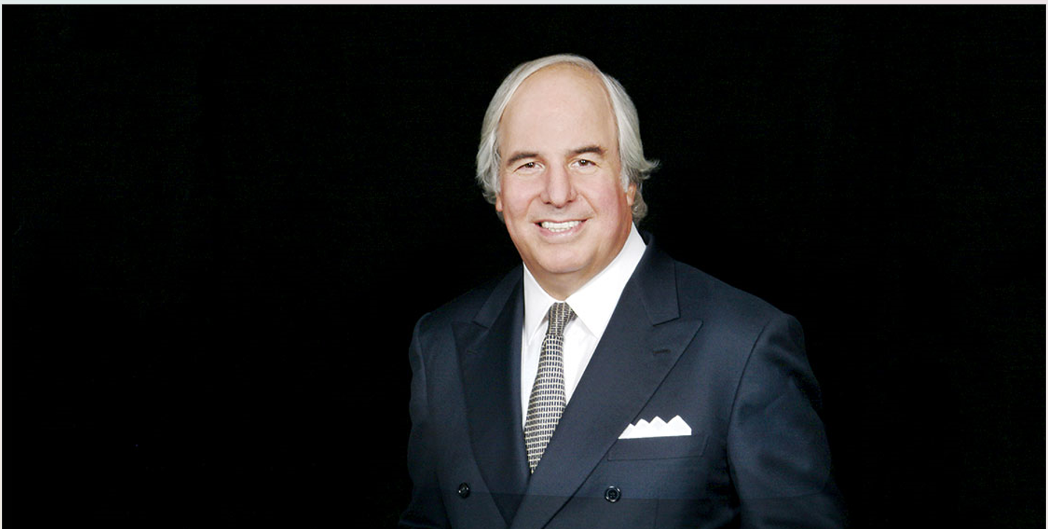
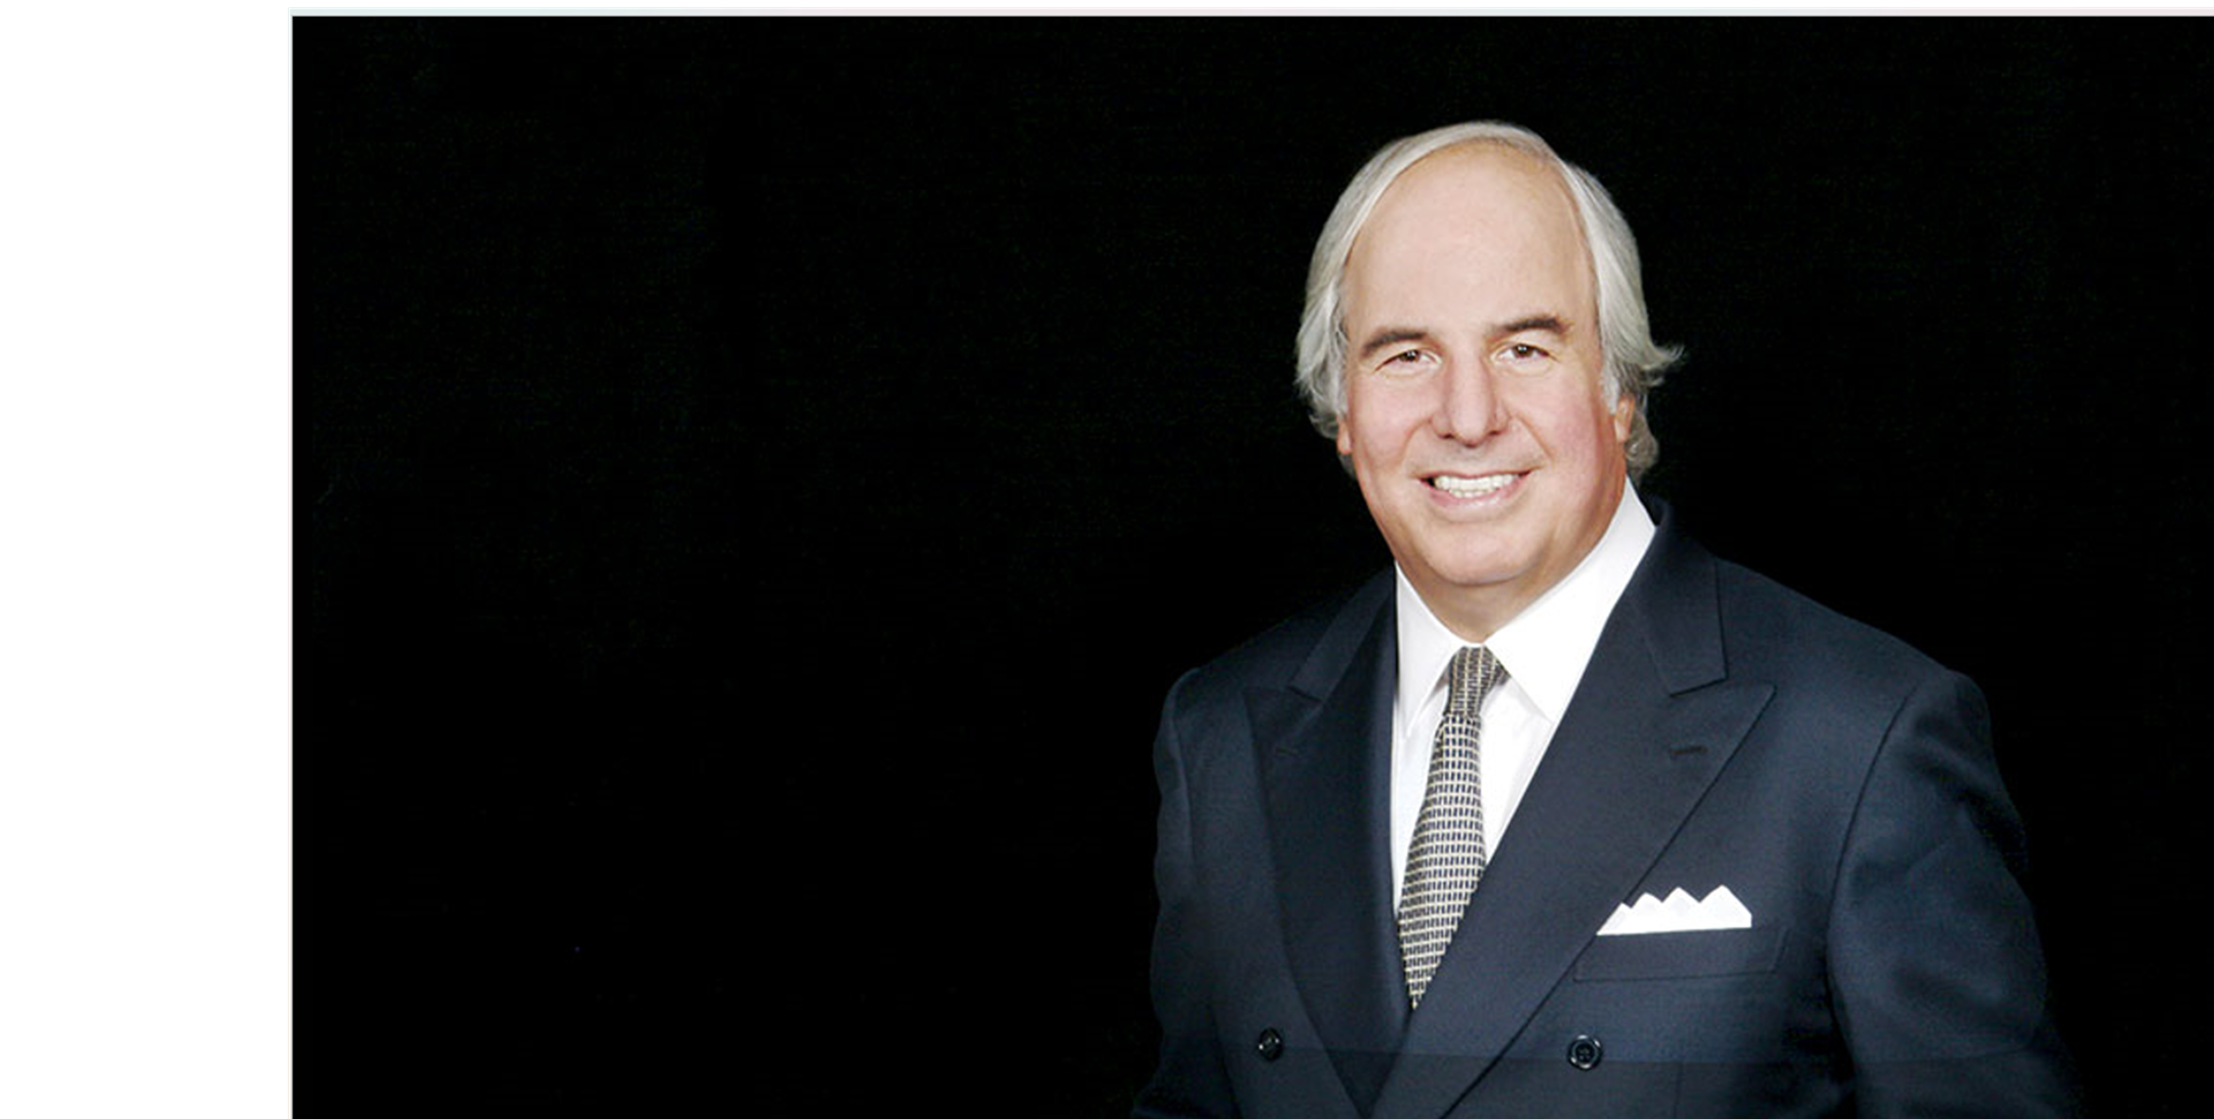
Frank Abagnale
FPPTA 39th Annual Conference

