Slide 1
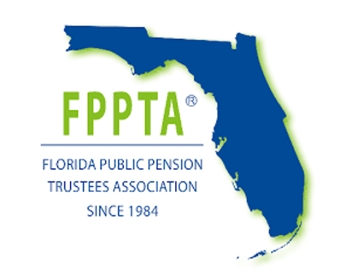
Fiduciary Prudence in Times of Headwinds
Ash Williams
Ken Harrison
Jerry Navarrete
Don Trone

Slide 2
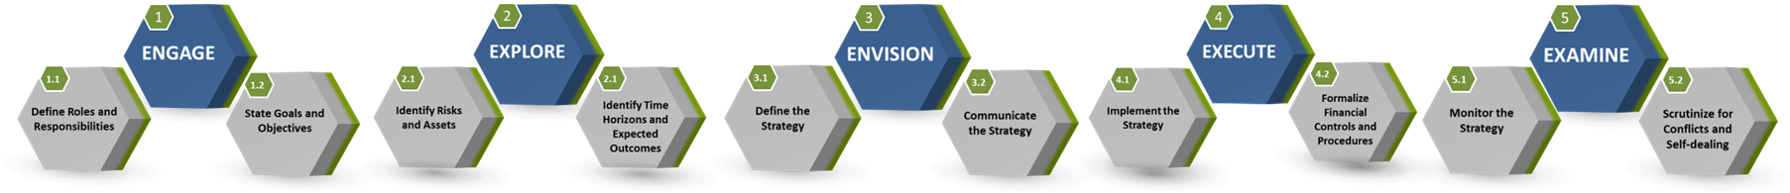
UNIVERSAL GUIDING PRINCIPLES FOR FPPTA PENSION BOARDS
Determine key decision-makers; identify who’s going to lead
Determine sources and levels of risks that may prevent goal attainment
Develop a strategy considering RATE - Risks, Assets, Time Horizon, and Expected Outcomes
Determine whether the right resources, people, and technology are in place
Monitor the strategy to periodically determine whether goals and objectives can be met
Collaboratively develop goals
and objectives with key
decision-makers
Determine sources and levels of assets available for goal attainment
Verify the strategy is inclusive of generally accepted best practices
Employ a consistent due diligence process when selecting prudent experts
Reallocate resources, when necessary, in order to meet goals and objectives
Align goals and objectives with organization's mission and ethics
Determine each goal's time horizon
Verify key decision-makers have the time, talent, technology, and temperament to implement the strategy
Control and account for costs, fees, and expenses
Ensure same due diligence process that was used to select prudent experts is also used to monitor the experts
Align goal and objectives with regulations, policies, and procedures
Determine each goal’s short-term objectives
Confirm reasonableness and appropriateness of costs, fees, and expenses
Formalize process to monitor for self-dealing and conflicts of interest
Brief all key decision-makers on the strategy
Copyright © 2020-2022. Center for Board Certified Fiduciaries, subject to additional licensing agreements with 3ethos and Hannah Leader Development Associates

Slide 3
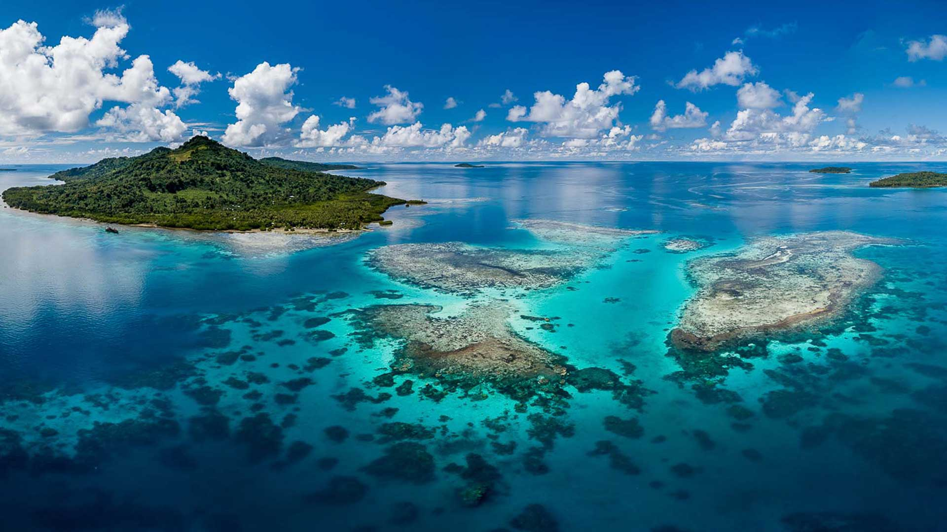
You demonstrate prudence by the process by which investment decisions are managed.
No investments are imprudent on their face.
It is the way in which they are used, and how decisions as to their use are made, that will be examined to determine whether the prudence test has been met.

Slide 4
THE HIERARCHY OF DECISIONS
TIME HORIZON
What is the time horizon of the investment strategy?
What asset classes are appropriate?
ASSET CLASSES
ASSET MIX
What will be the allocation among asset classes?
What sub-asset classes will be considered?
SUB-ASSET CLASSES
Whether ESG is appropriate should be considered here
Most common ESG mistake is to reverse the hierarchy and to start here
ASSET MANAGER
Which manager/fund will be considered?

Slide 5
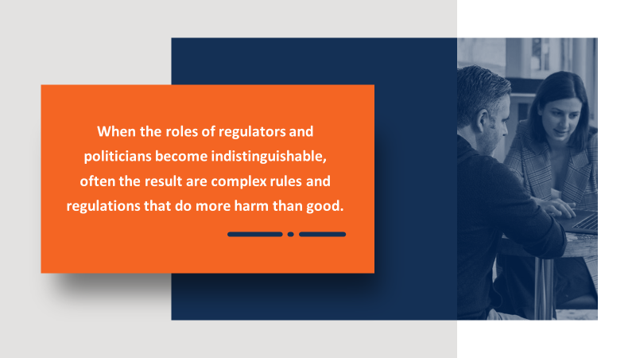
Typical Money Manager Due Diligence
When Pecuniary Factors Are Applied
Minimum track record
01
Minimum tenure
02
Assets in the product
03
‘Pecuniary’ - factors that are expected to have a material effect on risk and/or return
Fees and Expenses
Fees and Expenses
04
01
Peer group discipline
Peer group discipline
05
02
Holdings consistent with peer group
06
Risk adjusted return
Risk adjusted return
07
03
Performance
Performance.
Regulatory
Oversight
08
04
09

Slide 6
ESG PERFORMANCE OVER THE LONG-TERM:
Other
Managers
ESG
Investment
Performance
ESG will typically outperform when active managers are beating indexes.
ESG will typically underperform when indexes are beating active managers.
Be aware of end-point sensitivity

