Slide 1
Resources Representing the Florida Pension Community
Tyler Bond
Research Director, NIRS

Slide 2
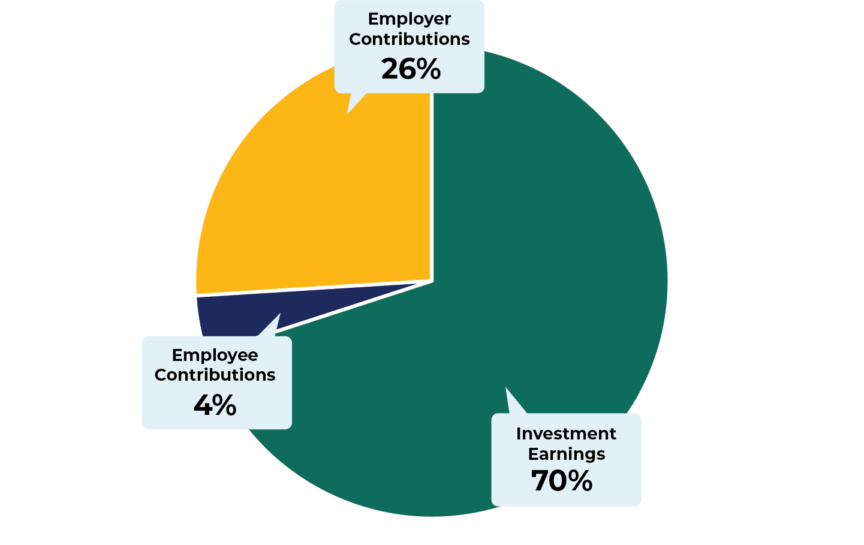
Sources of Pension Plan Income: Florida

Slide 3
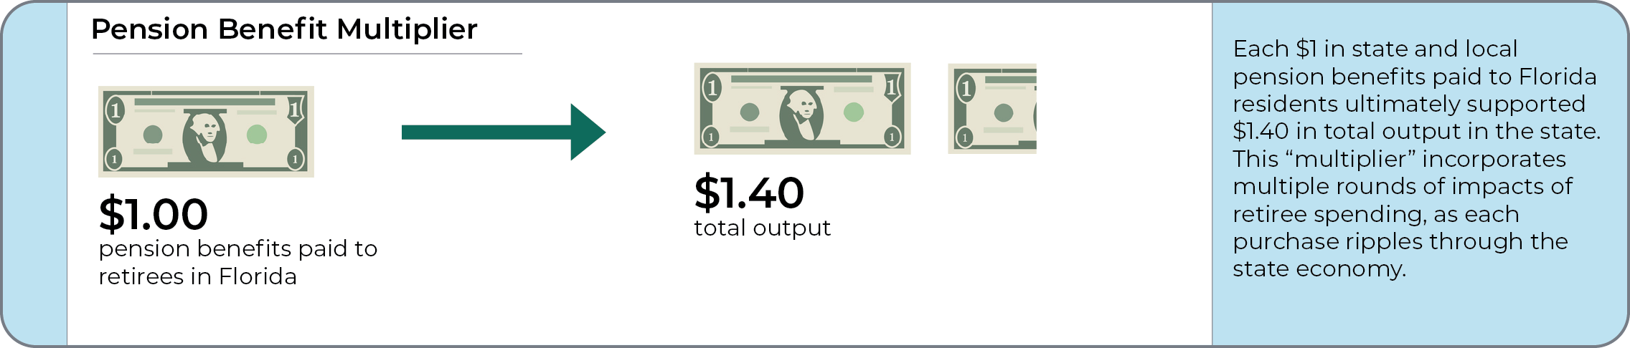
Pension Benefit Multiplier: Florida

Slide 4
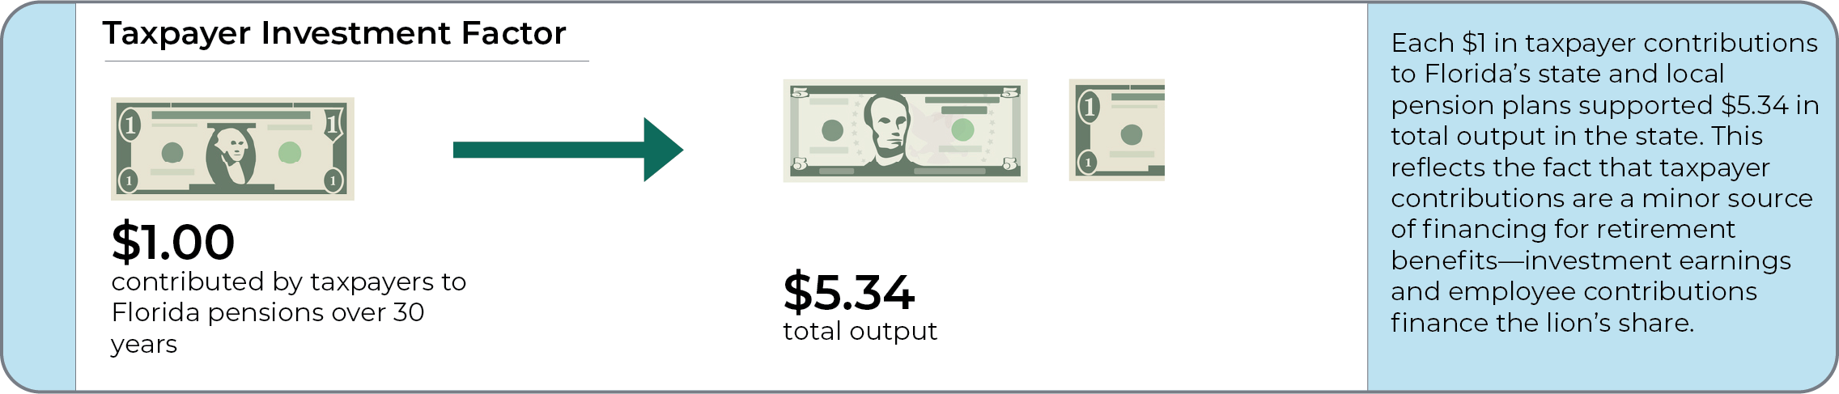
Taxpayer Investment Factor: Florida

Slide 5
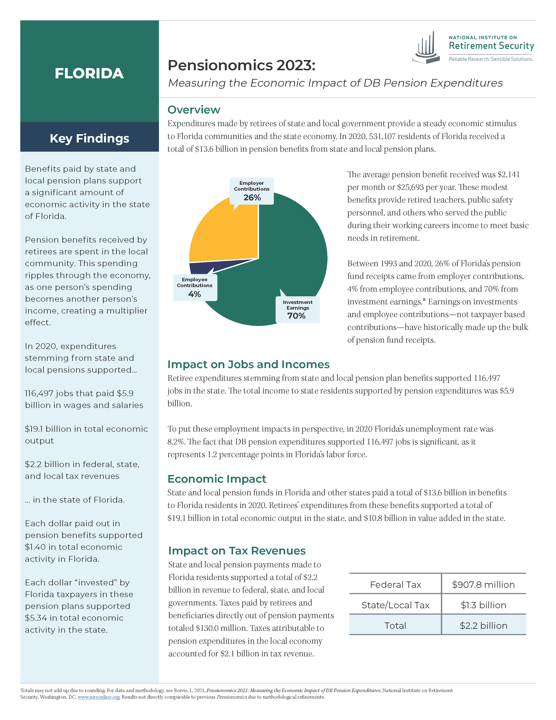
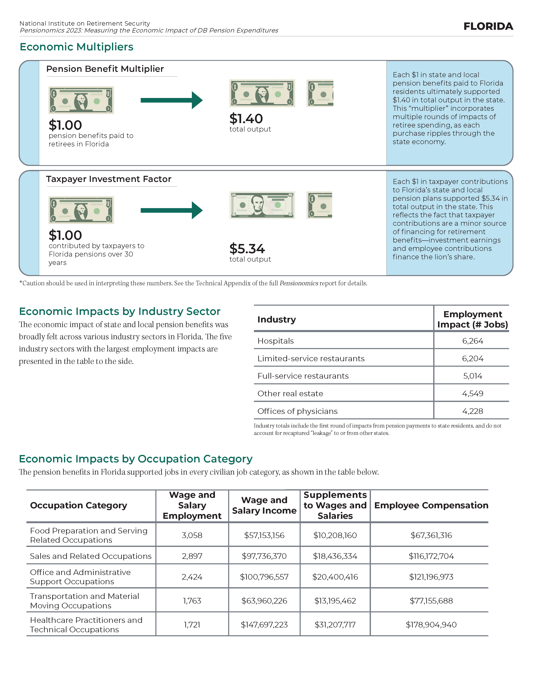
Florida Pensionomics Fact Sheet

Slide 6
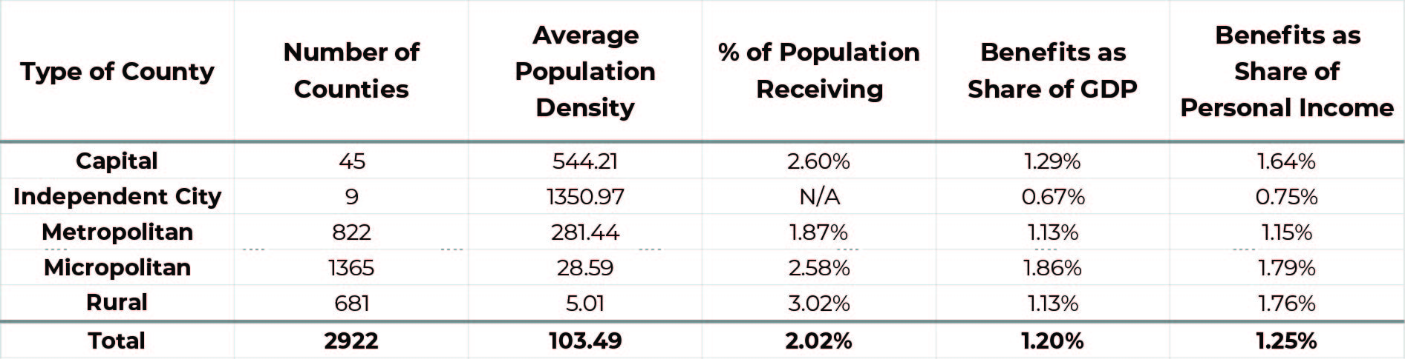
Fortifying Main Street

Slide 7
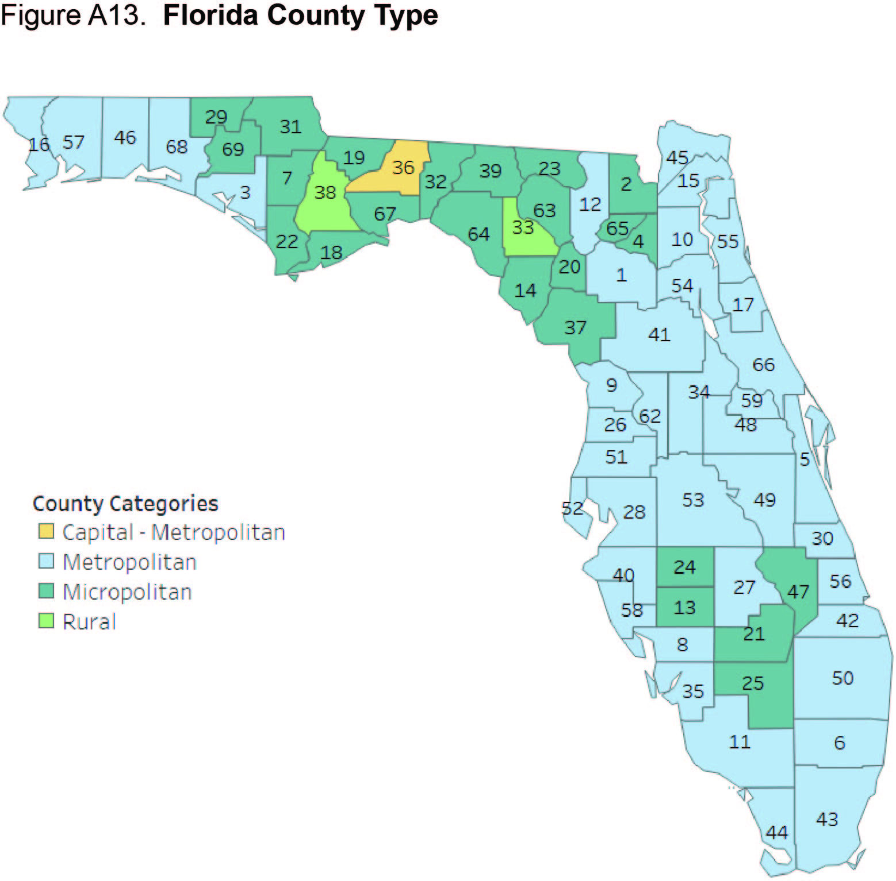
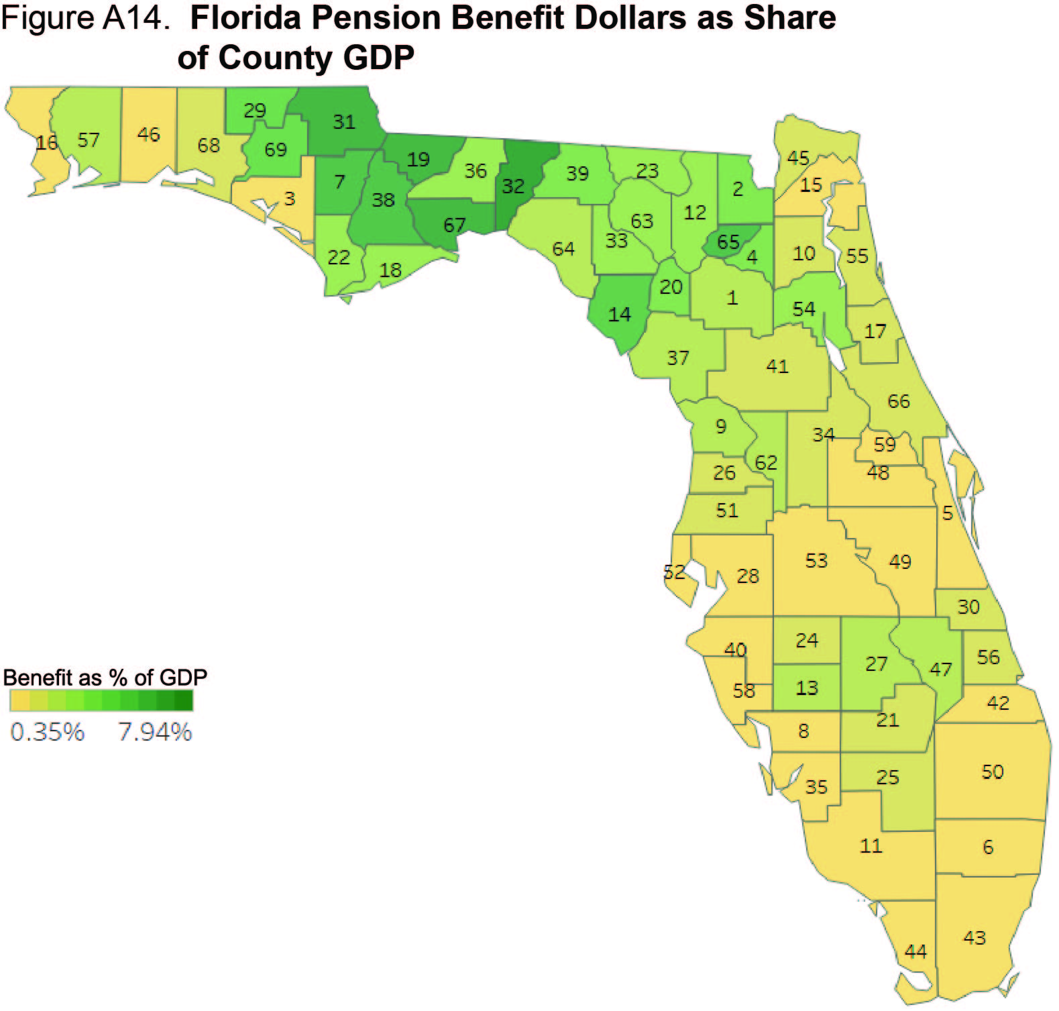
Florida: Share of GDP

Slide 8
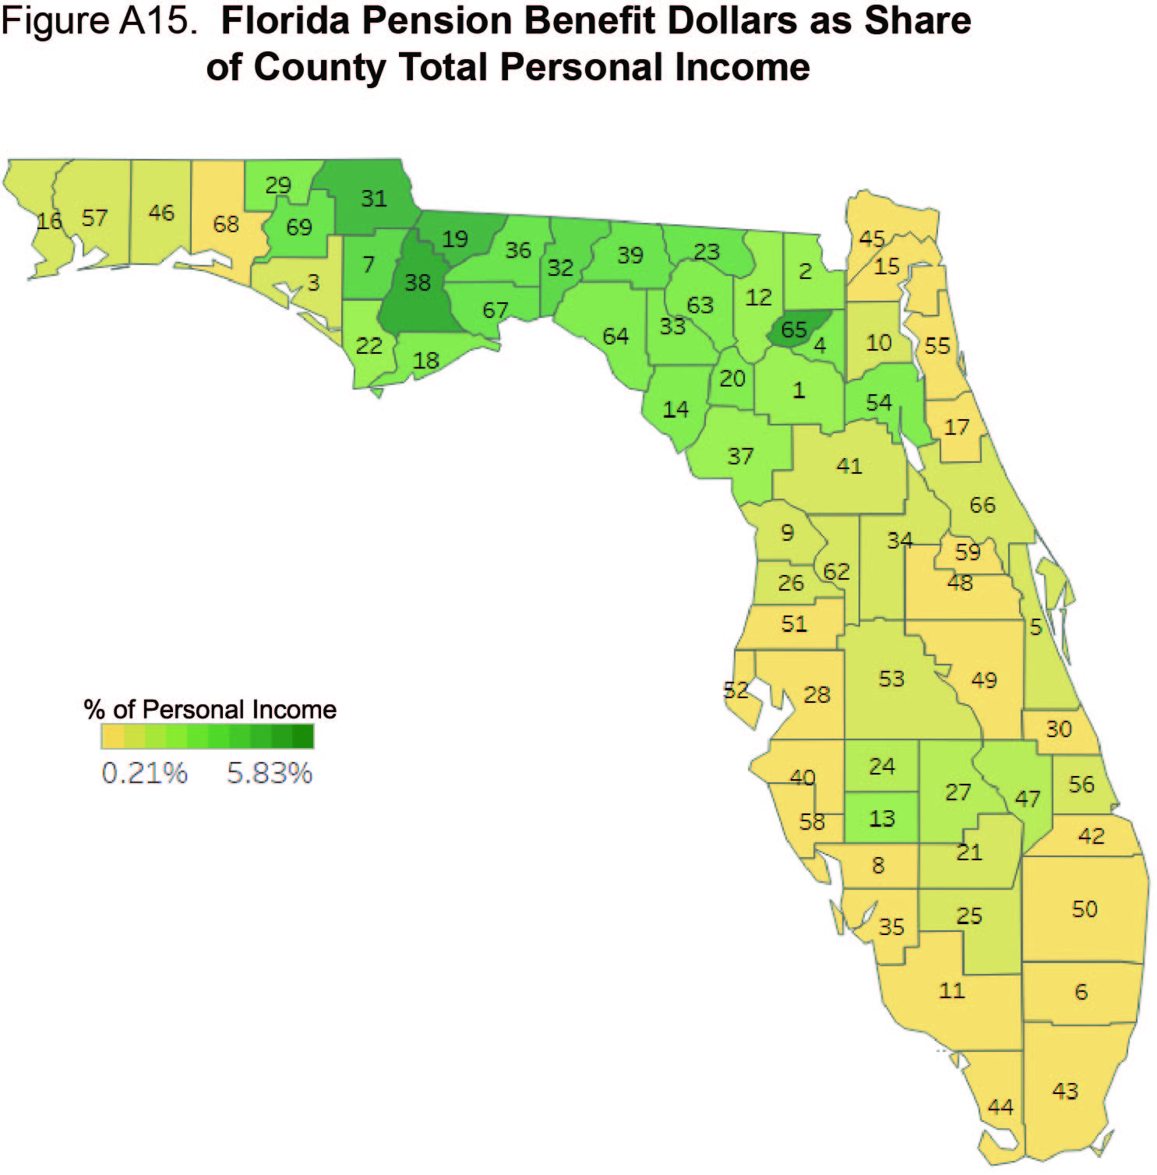
Florida: Share of Personal Income

Slide 9
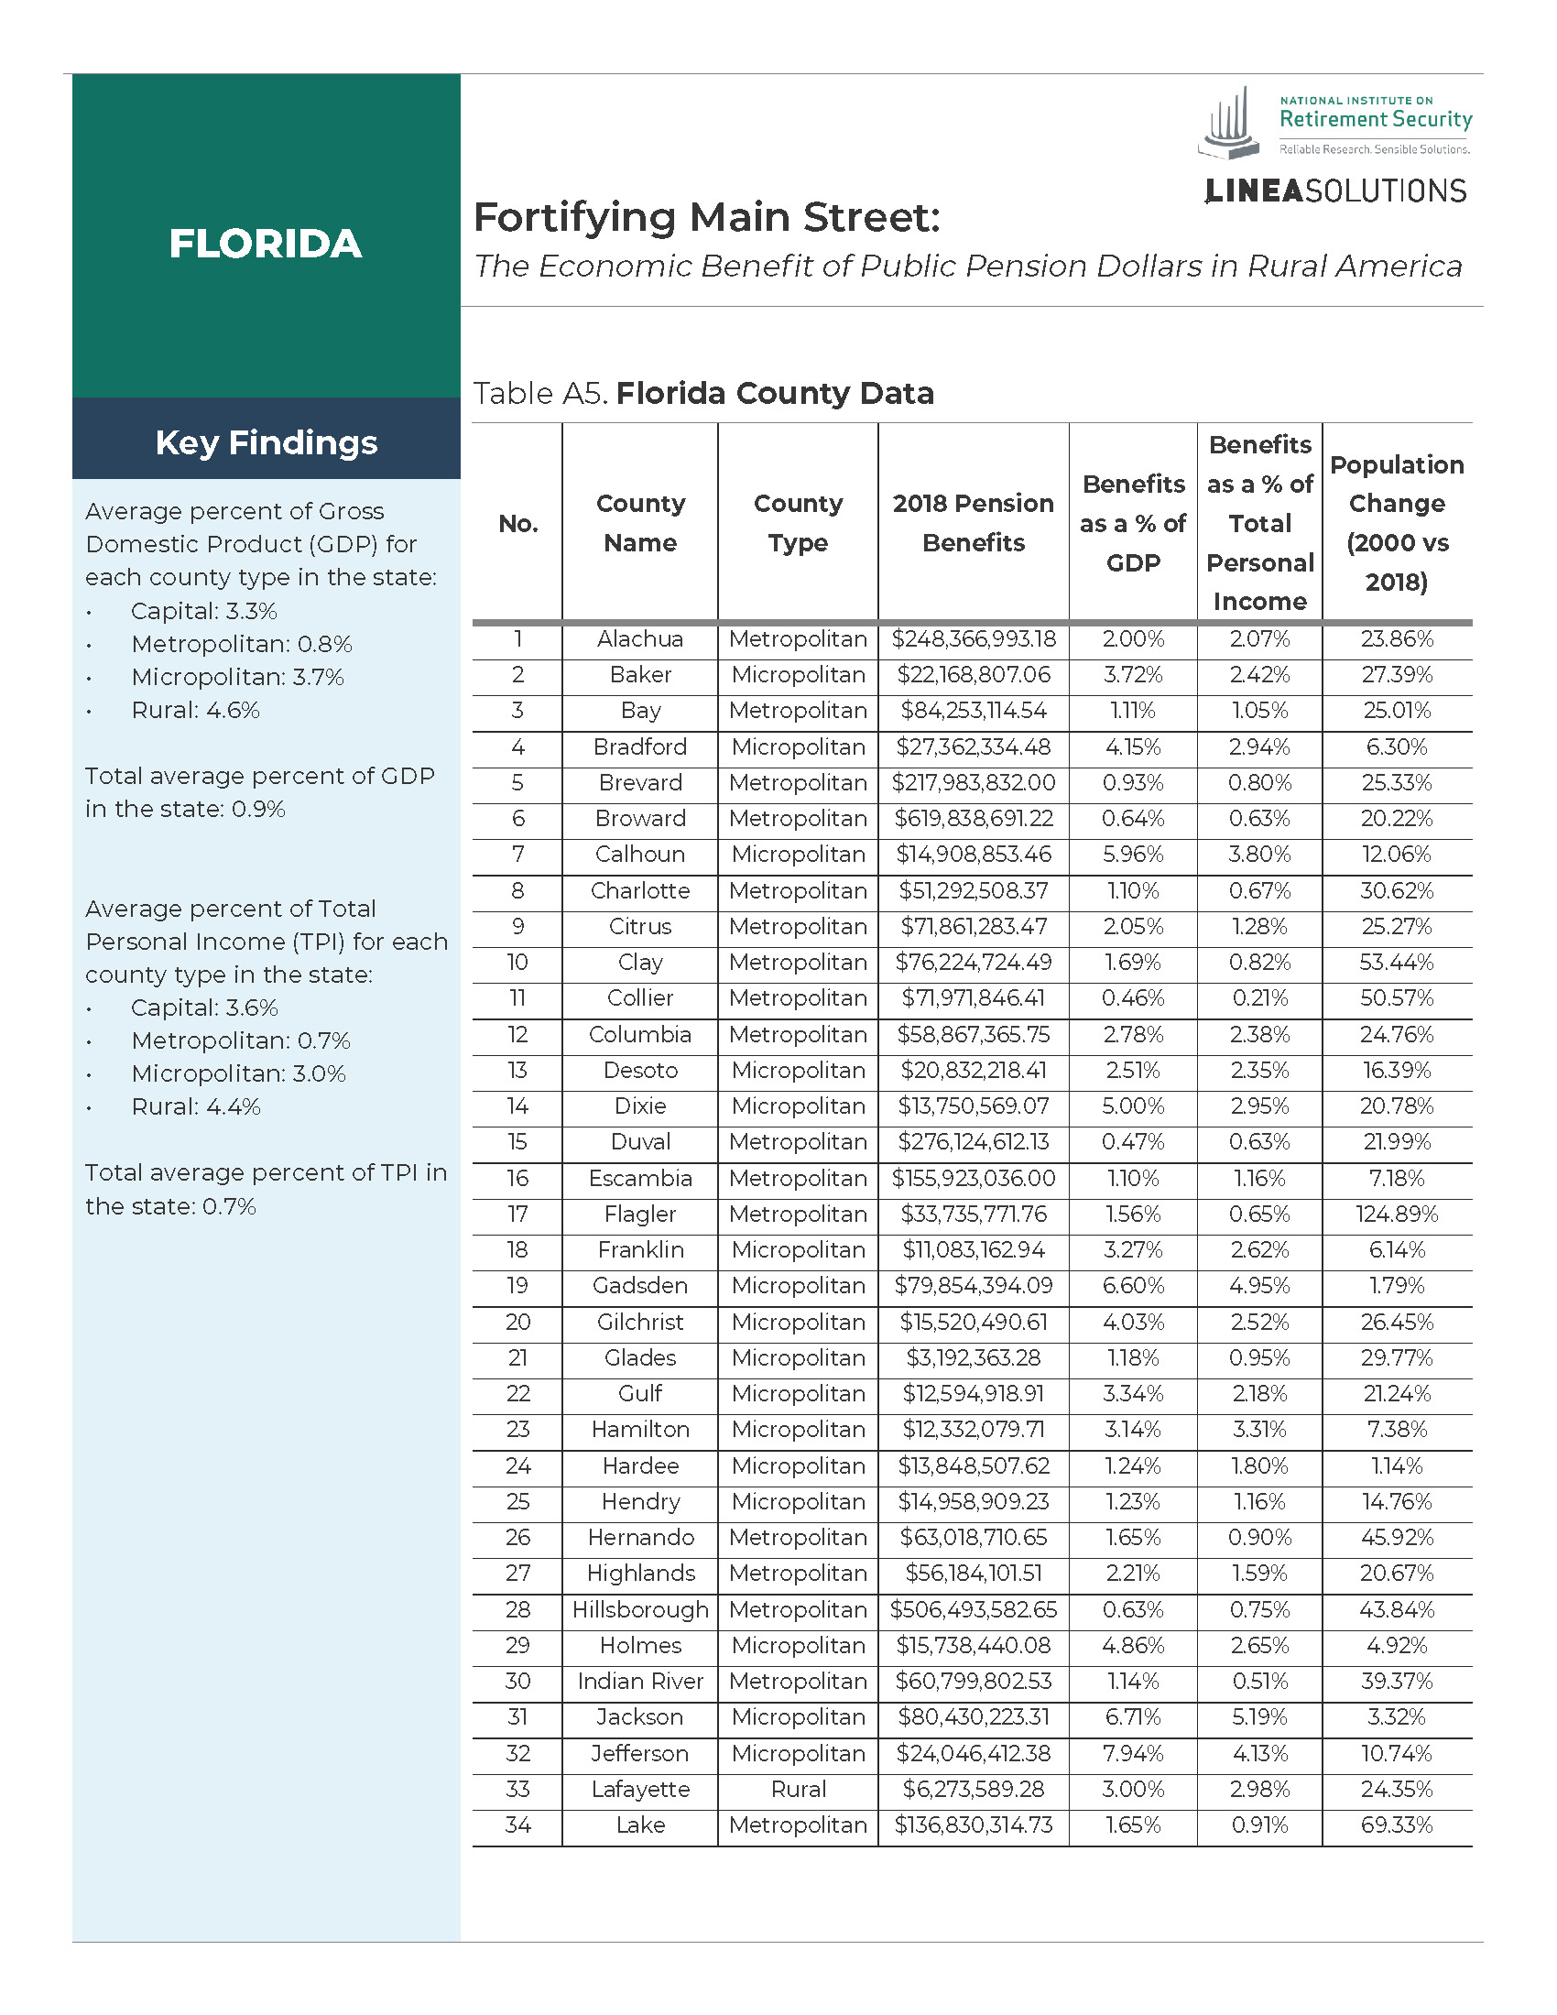
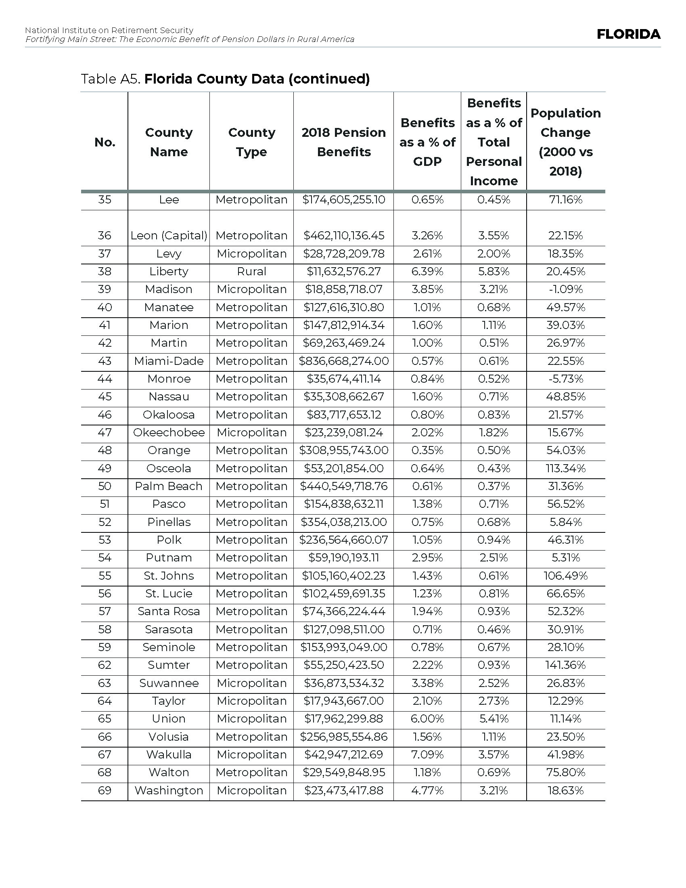
Florida Fortifying Main Street Fact Sheet

Slide 10
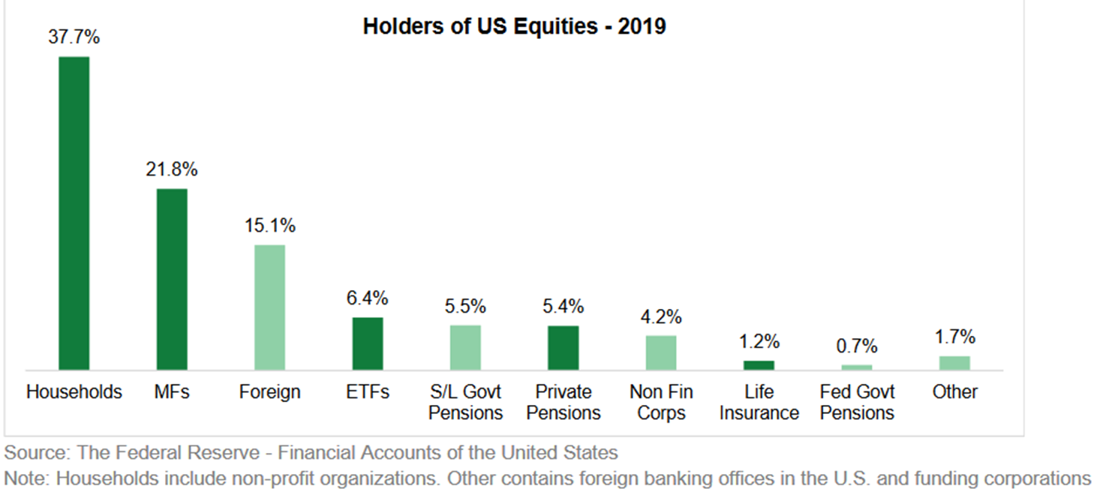
Pension Plans Own U.S. Public Equities

Slide 11
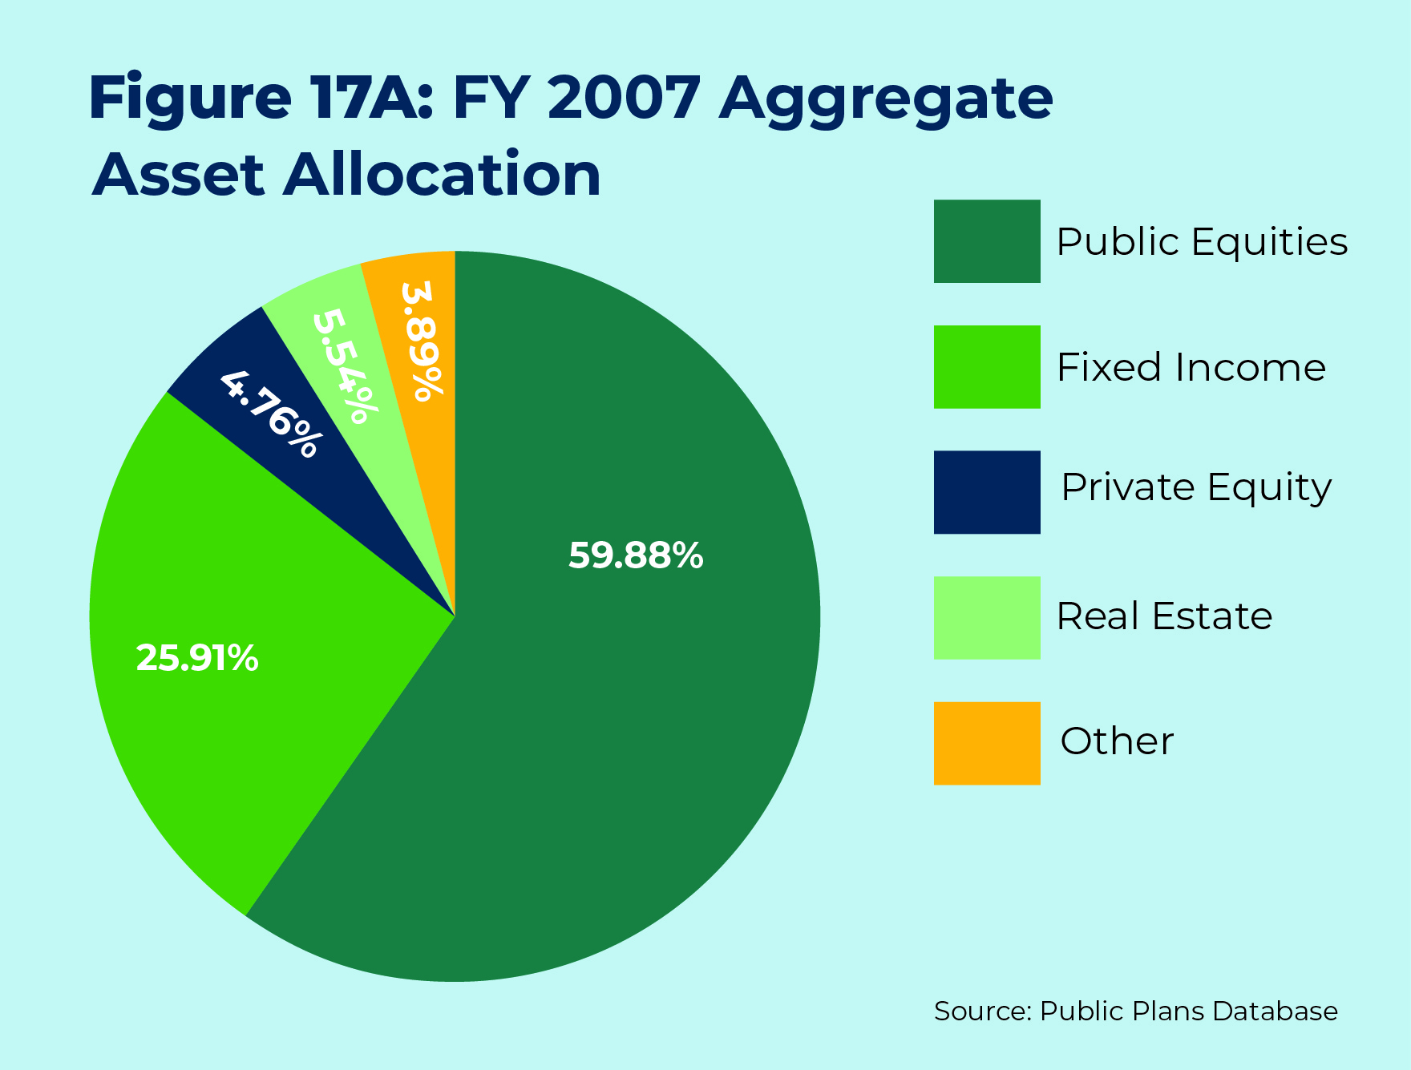
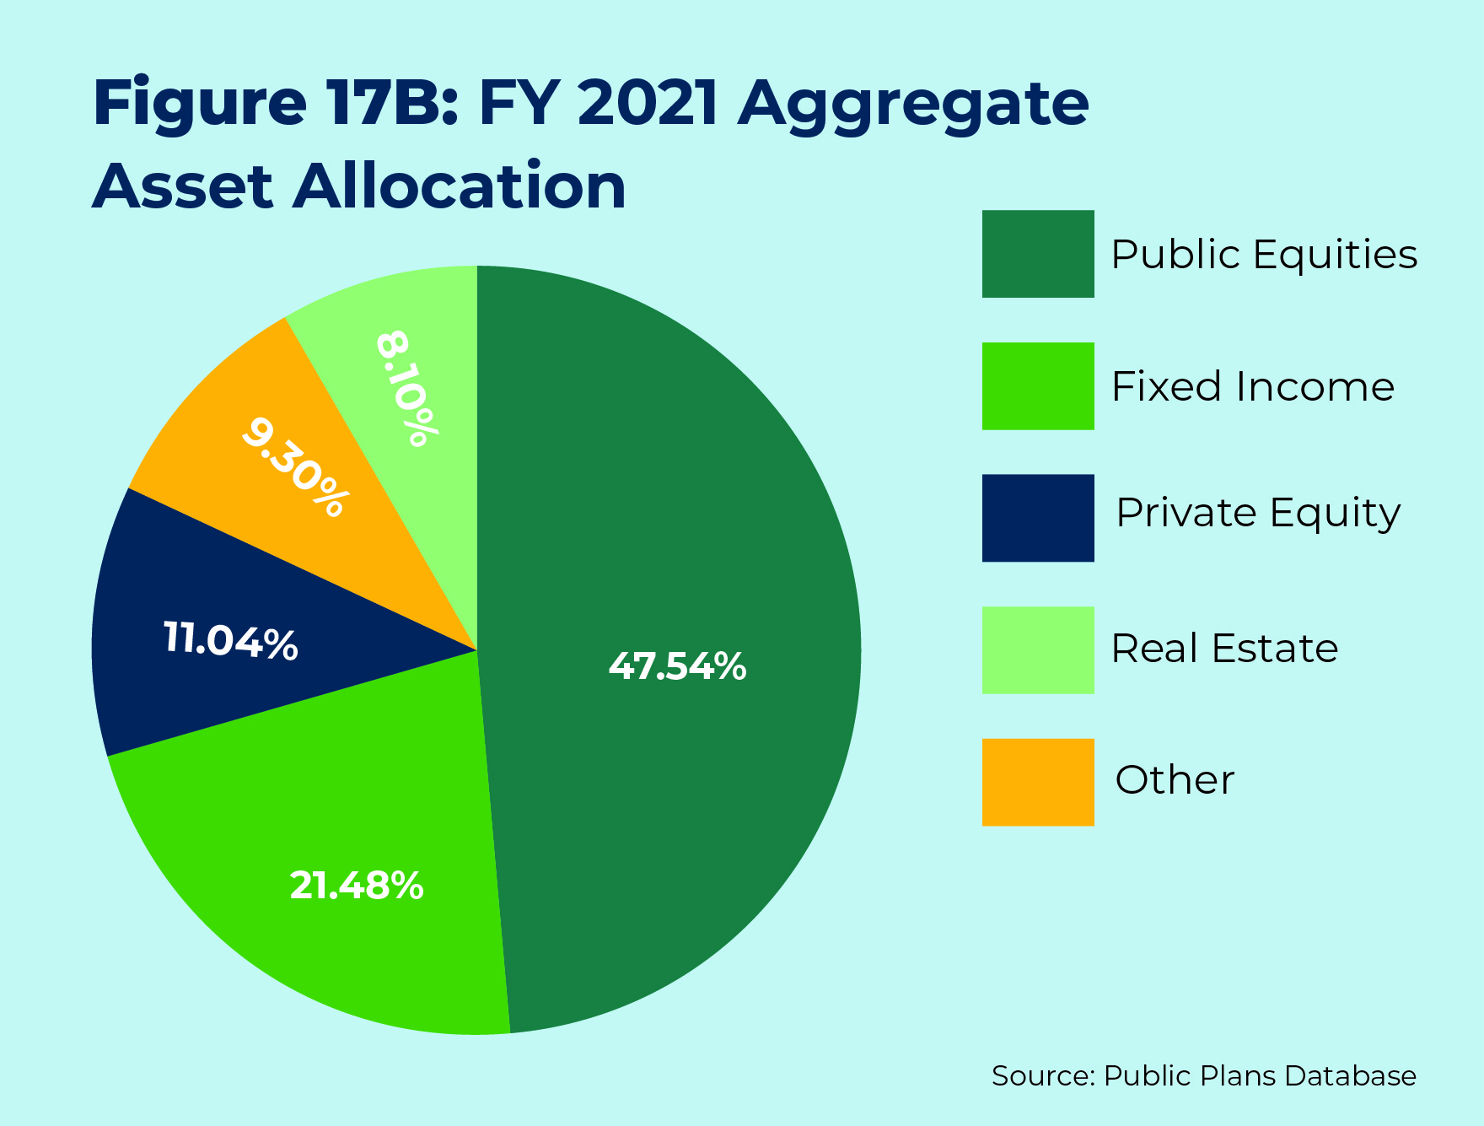
DB Plans Actively Rebalance

Slide 12
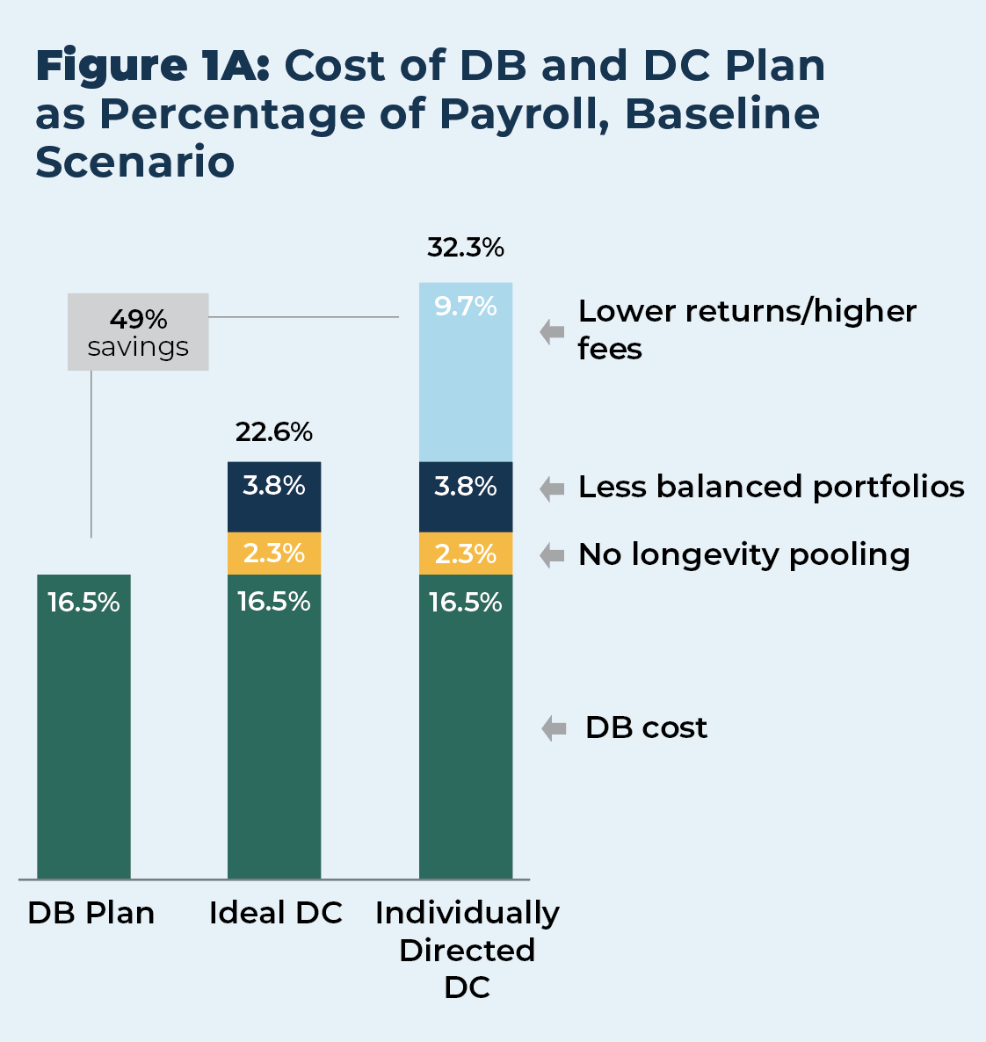
DB Plans Are More Economically Efficient Than DC Plans
DB pension plans can provide a given level of benefits at half the cost of DC plans:
Longevity Pooling
Optimally Balanced Investment Portfolios
Professional Investment Management

Slide 13
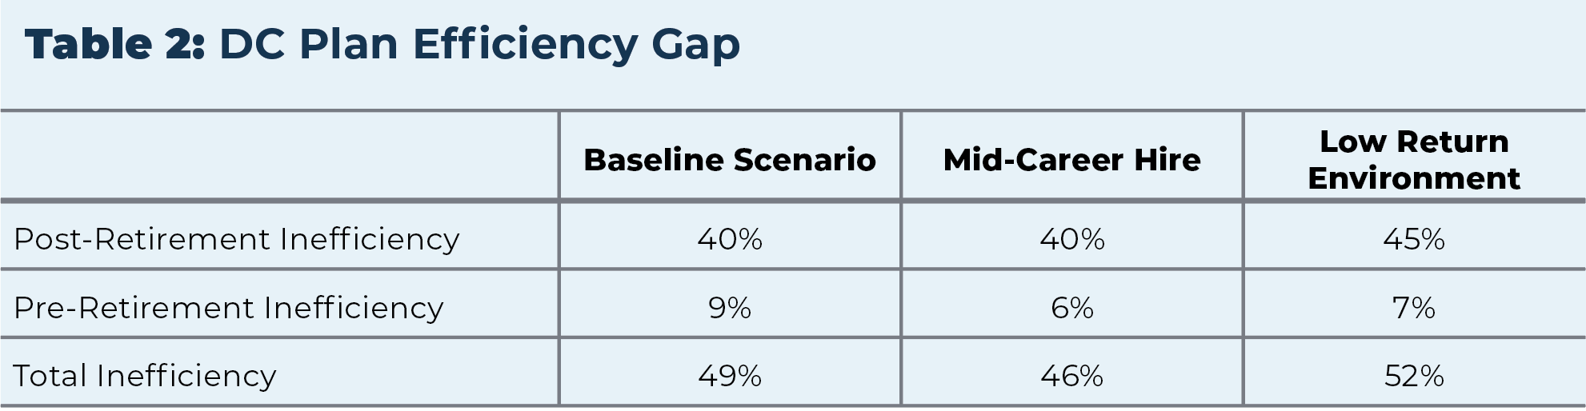
DB Plans Are More Economically Efficient Than DC Plans (Continued)

Slide 14
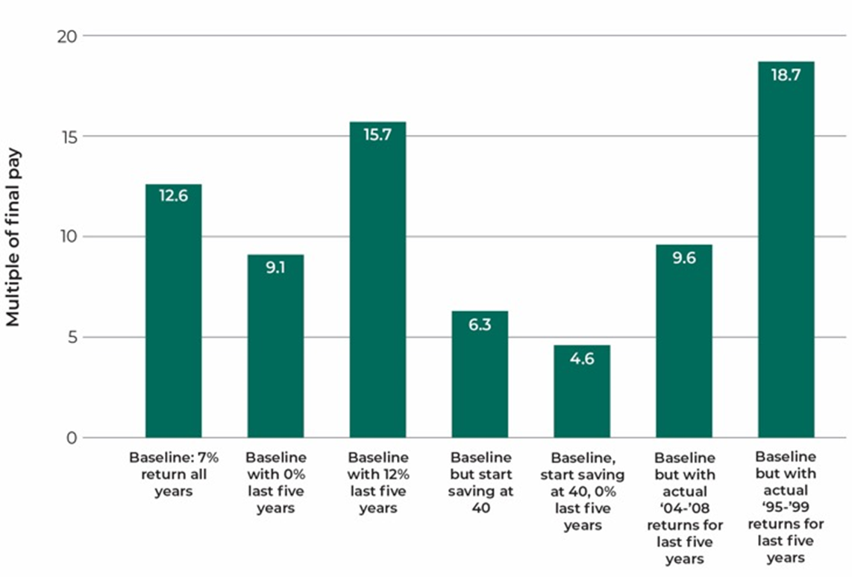
DC Savings Can Vary Greatly Due to Timing

Slide 15
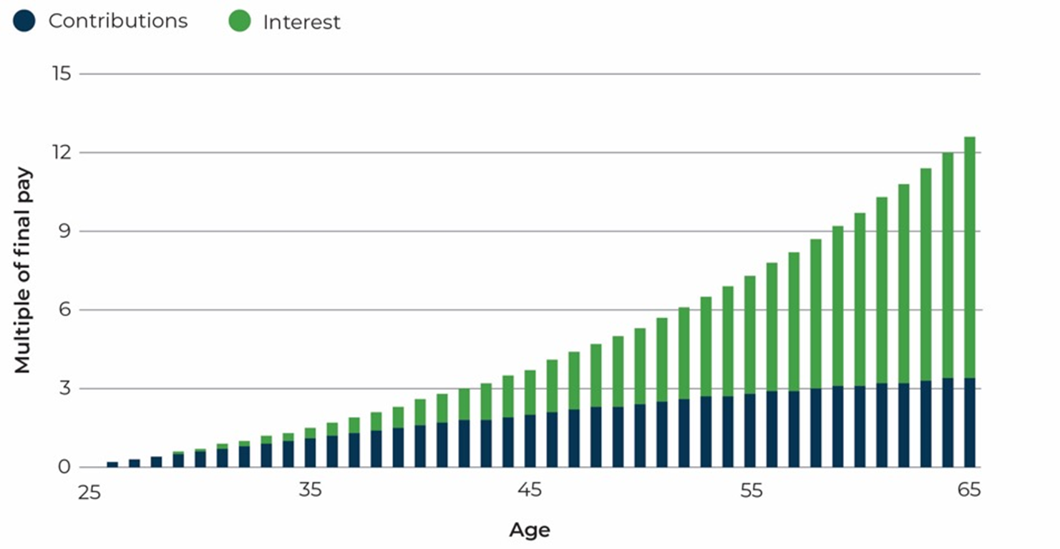
Interest Earnings Account for Much of the Late Growth in DC Plan Assets…

Slide 16
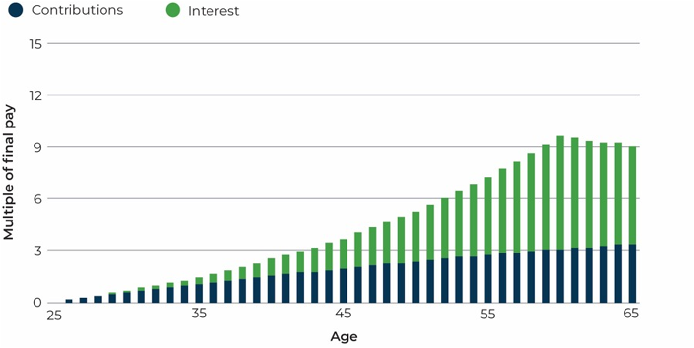
…But That Makes Them Vulnerable to Market Downturns

Slide 17
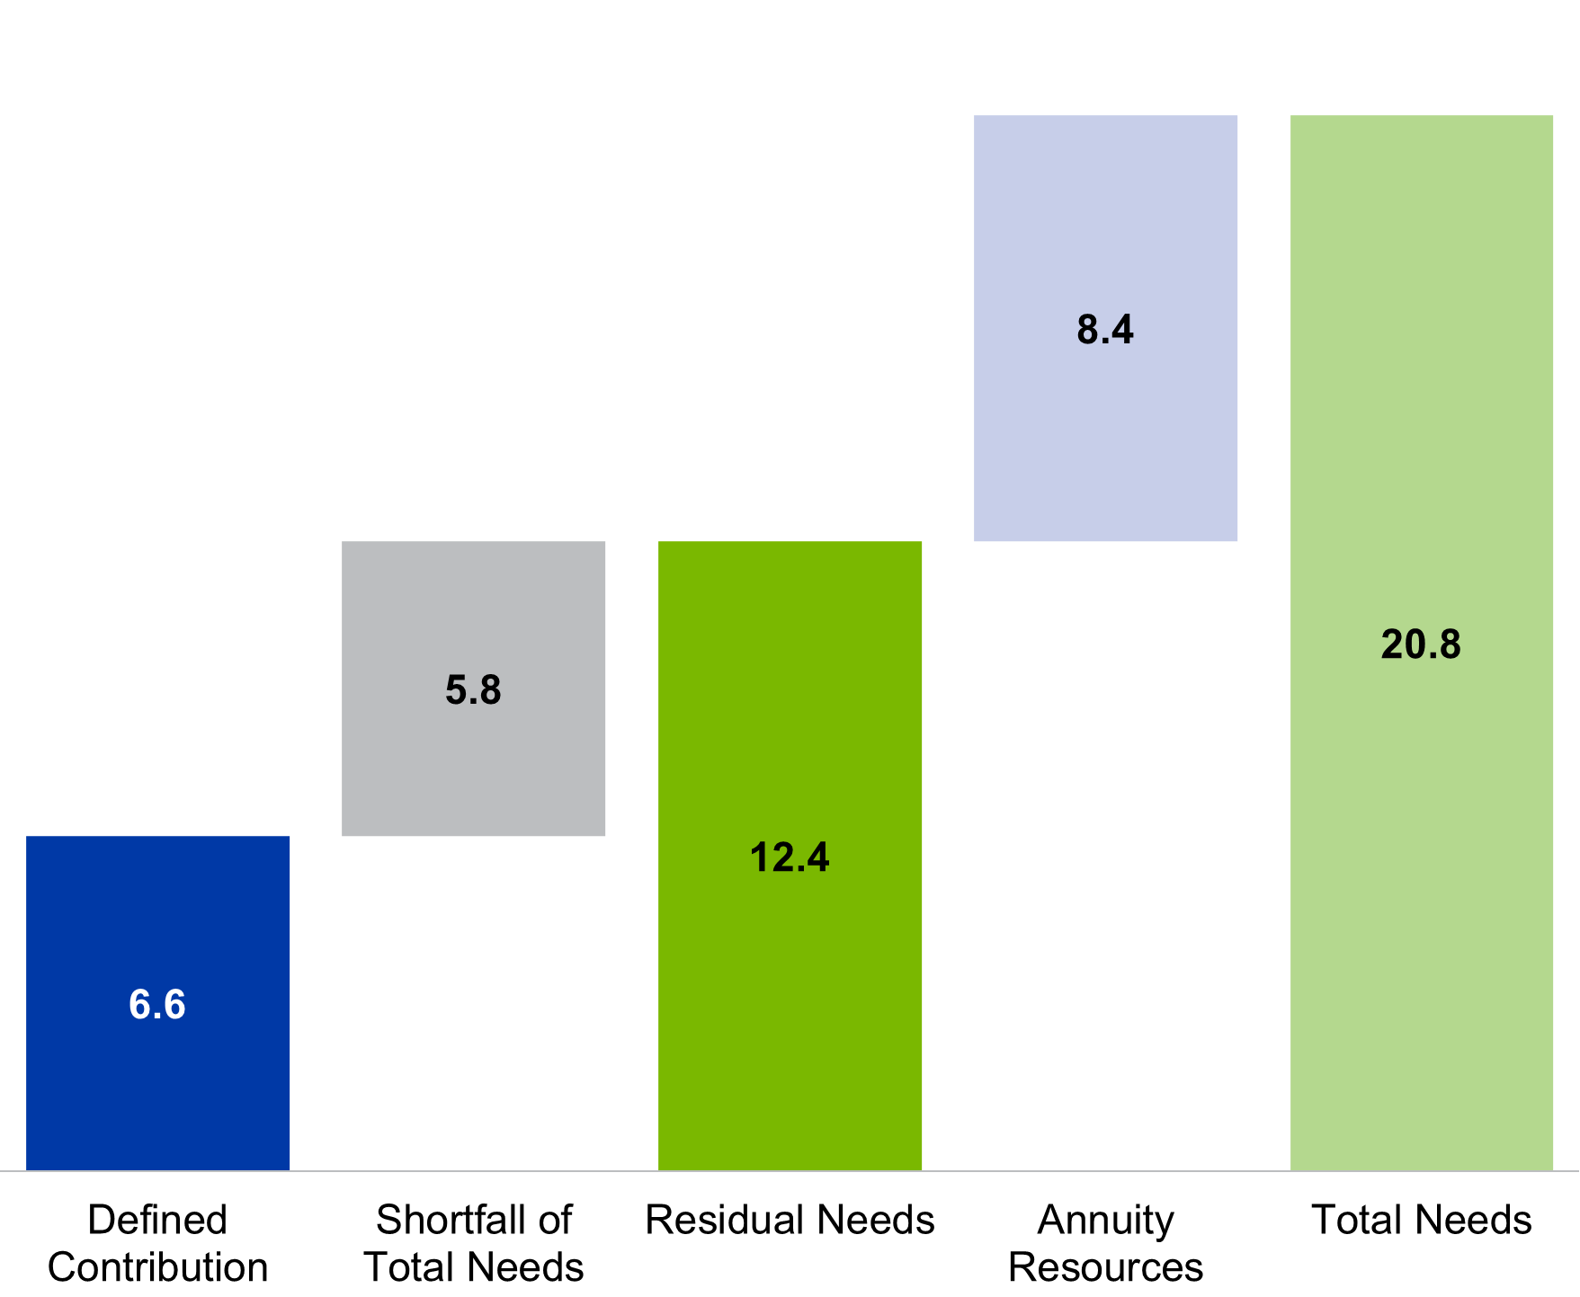
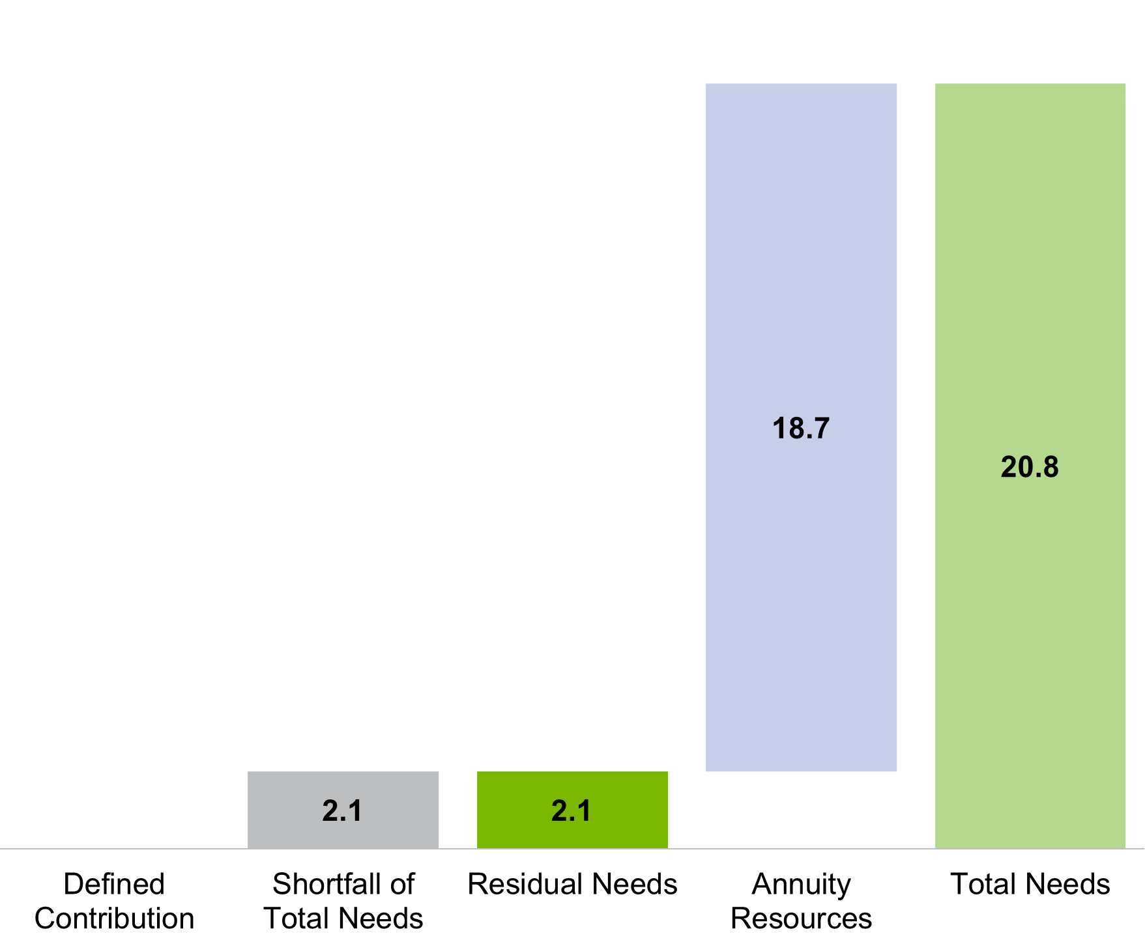
DB Plans Meet Needs Better Than DC Plans

Slide 18
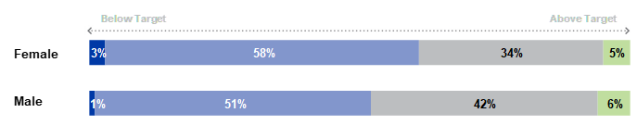
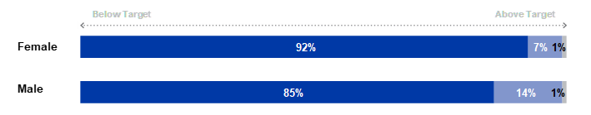

DB Plans Provide More Resources for Women in Retirement

Slide 19
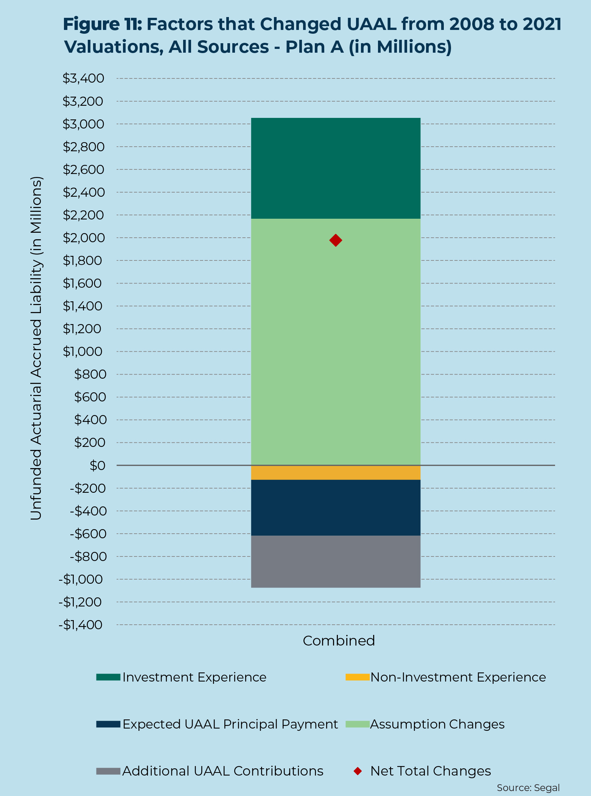
Pensions Are More Transparent About the Costs of Retirement
Assumption changes accounted for all of the increase in Unfunded Actuarial Accrued Liability (UAAL) in the example plan. All of the other factors offset each other.
Source: Examining the Experiences of Public Pension Plans Since the Great Recession

Slide 20
What’s Next at NIRS?
Generation X and Retirement Security
Update of Enduring Challenges
The Role of Public Pension Plans in Financial Markets, i.e., pensions as long-term investors
Public Opinion Research
Police and Fire Pension Retention Study

